Slide 1
Python for Astronomy
ASTR 302, Winter quarter 2026
ivezic@uw.edu

Slide 2
Today
Why Python for Astronomers?
Administrivia
Getting set up (JupyterHub & Slack)

Slide 3
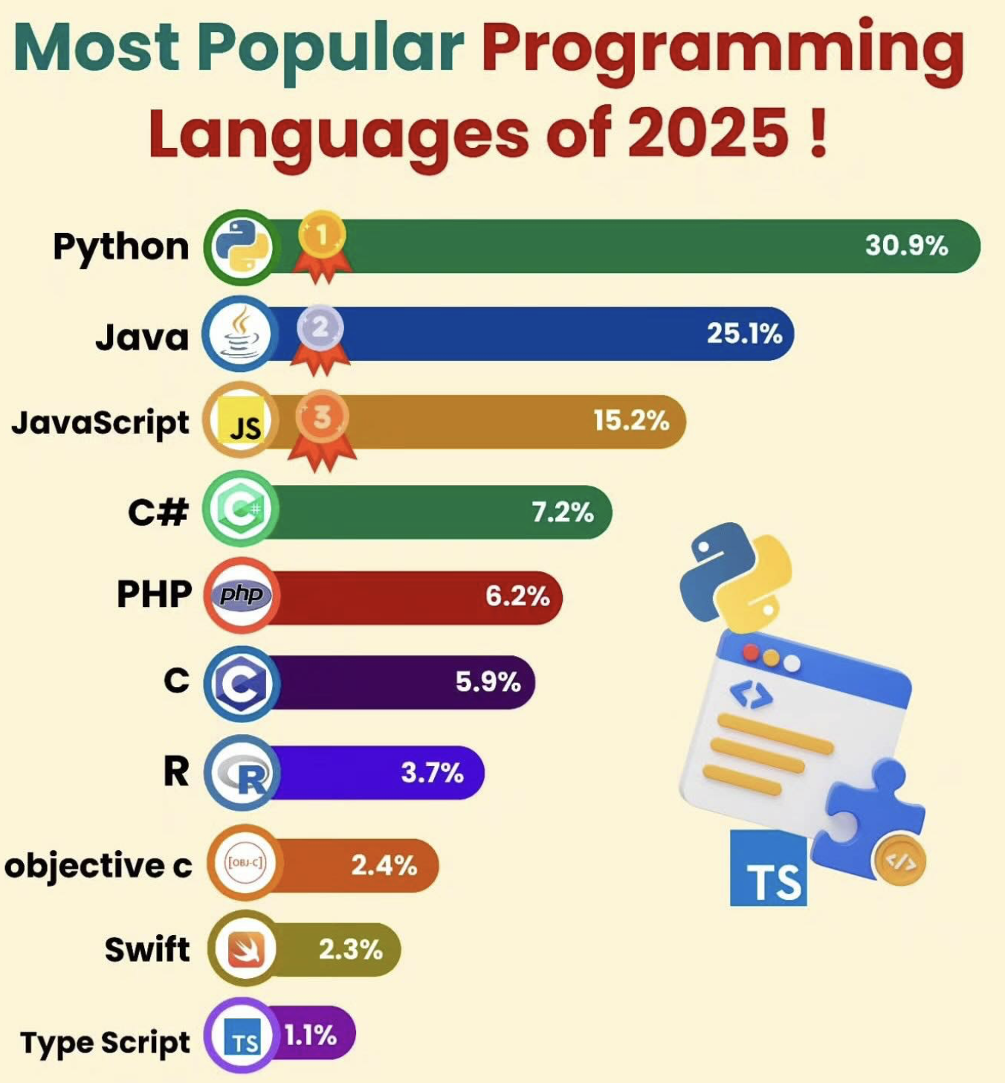

Slide 4
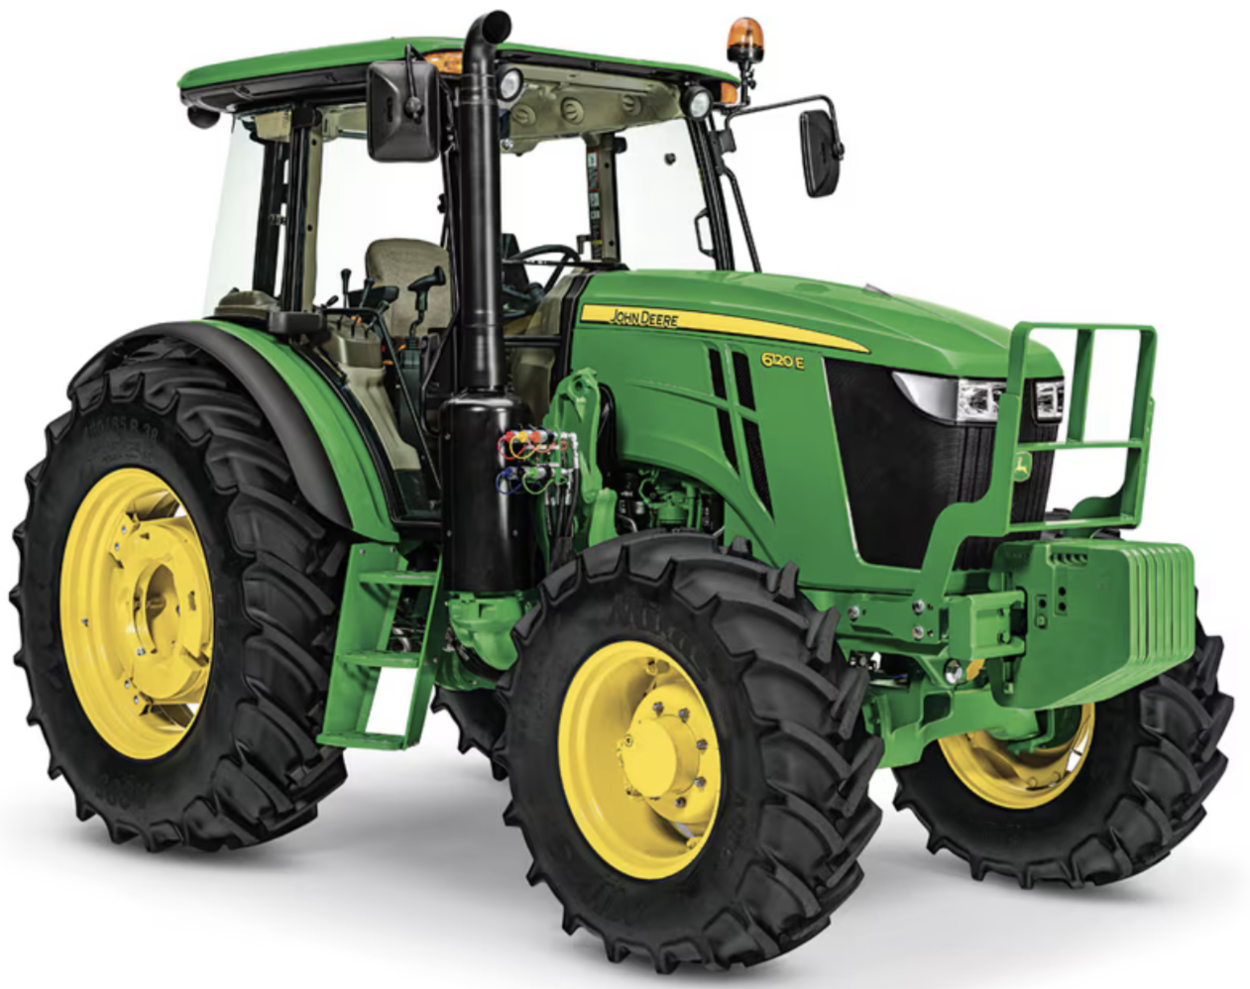


Similar but optimized differently...

Slide 5
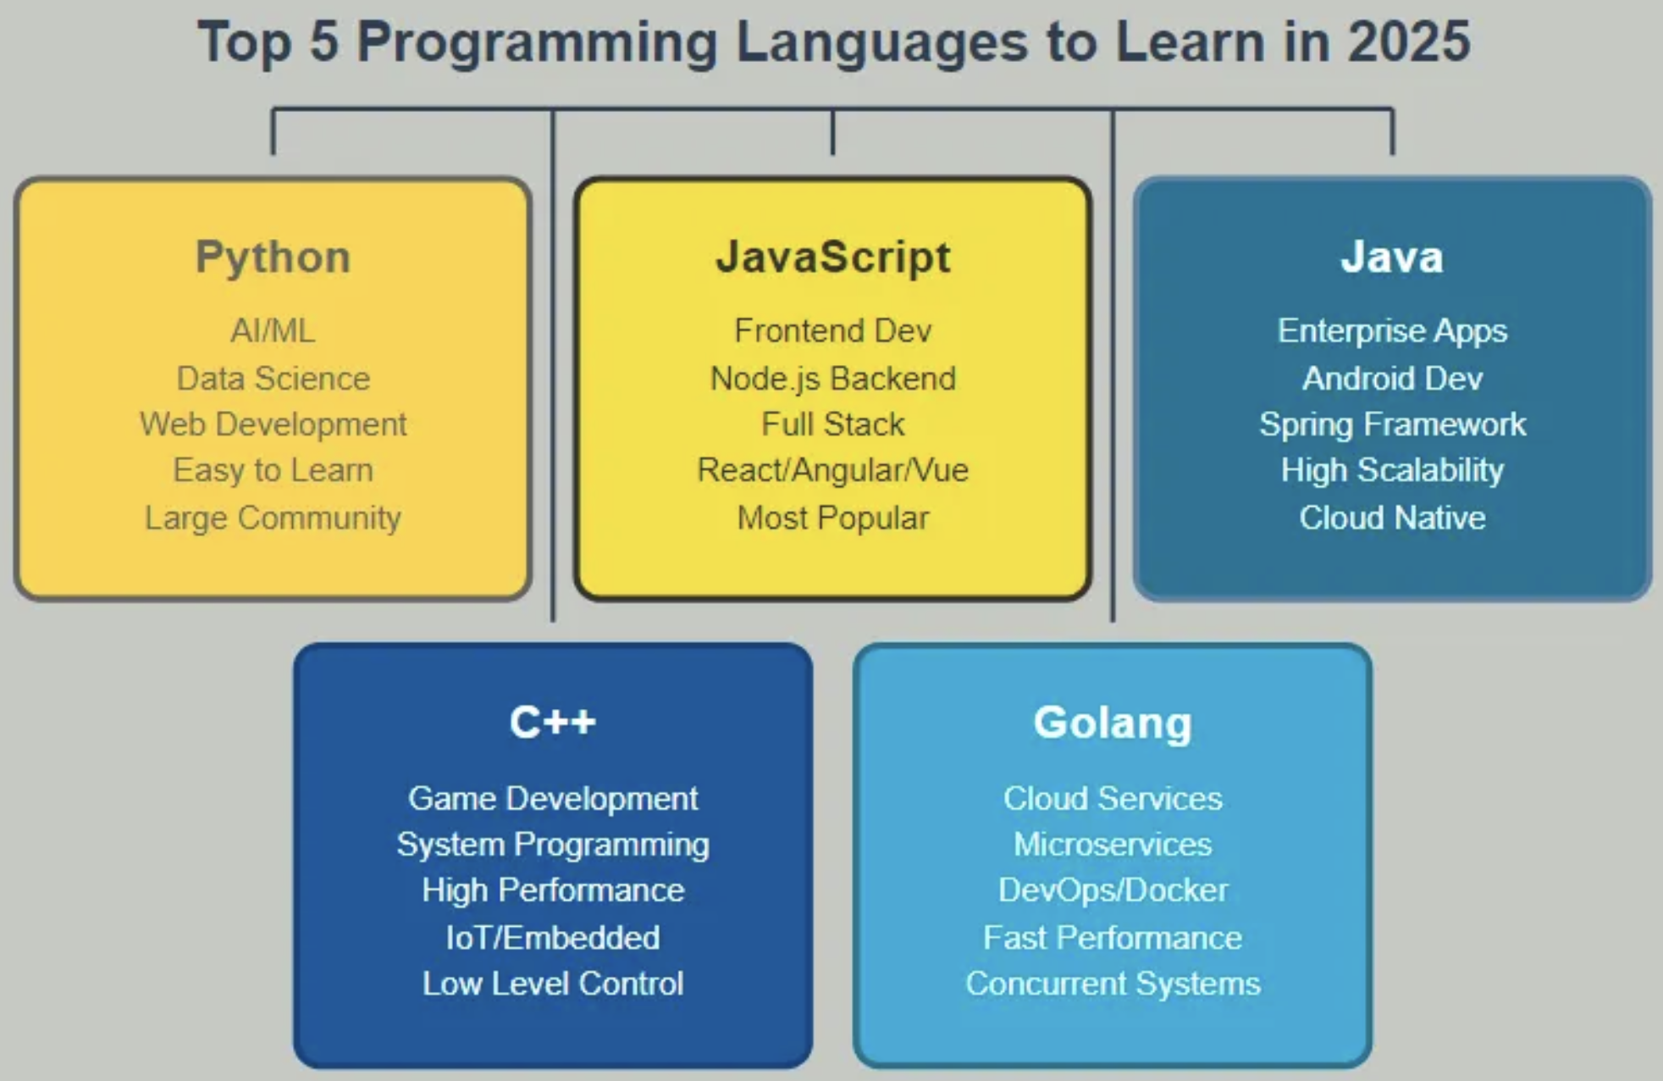

Slide 6
Why Python for Astronomers?
Python has recently become the common language of astronomy (specifically, astronomical data analysis).
The goal of this course is to teach you how to effectively use the tools available in the Python ecosystem (the language, the libraries, and the concepts underpinning both) for your research. Think of it as a part of a series: ASTR 300 -> 302 -> 324 -> 497 (Astro Surveys & Big Data).
While motivated by astronomy, the skills learned here should be broadly useful. It should easily transfer to more general data-science work.

Slide 7
Why Python?
Higher-level languages, in general, shorten your time to research results. Python is one such language that is easy to learn, freely available, similar to legacy languages (IDL, FORTRAN, C/C++), and was mature enough at just the right time to spur adoption.

Slide 8
As usual, lunches don’t come free
Computational efficiency is the price you pay for speed of development. But that is typically a good trade to make.

Slide 9
From https://www.squareboat.com/blog/advantages-and-disadvantages-of-python
Advantages
- Comprehensive Libraries and Frameworks
- Ease of learning and use
- Highly Embeddable
- Automatic memory mgmt
- Open source and large community
Disdvantages
- Slow Execution Speed
- Dynamically typed
- High Memory Consumption
- Threading Limitations
- Database Interaction Challenges

Slide 10
How Many of you are comfortable with…
Writing a command-line Python script (.py)
Using Python lists()
Using Python dicts()
Using tuples
Writing Python functions
Writing Python classes
Writing a Python module
Working with numpy arrays
Making a mpl scatter plot
Plotting an image w. mpl
Exception handling
Writing a list comprehension
Writing a lambda function
Using decorators
Writing a decorator
Utilizing ABC classes
“Hey, look, a survey!”

Slide 11
“The Only Thing That Is Constant Is Change”
- typically attributed to Heraclitus
In astronomical data analysis (and related computing disciplines), things change too quickly to be learned only once. Learning is a process that never ends.
I will try to teach you what currently appears to be the best set of tools and techniques to have in your toolbox.
But know this will change. So the major emphasis of this course will be on understanding the concepts, and learning how to continuously keep your knowledge up-to-date.

Slide 12

Languages may change, but concepts transfer!

Slide 13
Learning how to Learn
We’ll also learn how to learn: how to discover information, keep your knowledge up-to-date, find leads that help you solve problems, evaluate their worthiness.
This may be the most valuable piece to take away from this class.

Slide 14
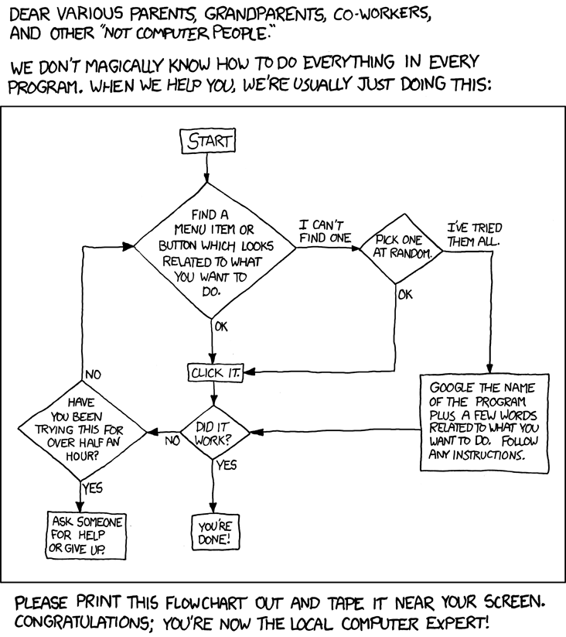

Slide 15
Class Projects
January: a short (re)introduction to the basics (Python, git, how to find information, teamwork & software dev. methodology).
Form a few “startups”, each with an (ambitious) product in mind.
4-5 people each. Work in teams, using github and agile sprints.
Example: Build a visualization widget for running some code
Example: Build a website to tell whether Rubin could find a newly discovered NEO
project pitch day: February 3
Feb-March: work towards that goal in weekly sprints

Slide 16
Lectures
When: Tue/Thu,10:00am-11:20am
Were & how: PAA 216
Please bring your laptops
Lecture structure (may change from week to week):
About an ~hour for introducing new material. !!! WILL BE HANDS-ON !!!
Leave ~20 minutes to work on homeworks, questions, open-ended discussion
Interrupt and ask questions at any time!

Slide 17
Course Materials
I’ll be adding most of what we need to the following repository on GitHub:
https://github.com/uw-astr-302/astr-302-w26
Action: Let’s make sure everyone can access this repository.

Slide 18
Textbooks & Reference Material
There is a wealth of material available online and as eBooks (for UW students, via UW Libraries & Seattle Public Library). The two I’d recommend to begin with:
+ many (many!) online writeups / blog posts that I will point you to over the next few weeks.

Slide 19
Syllabus
Available at: https://github.com/uw-astr-302/astr-302-w26/blob/main/syllabus/astr-302-syllabus.pdf
(this will take you to the class github repository).
Things to note:
The syllabus will change as we go through the quarter. Your feedback will be invaluable!

Slide 20
Grading, Homeworks, Etc.
Homeworks (30% of the grade):
Designed to exercise what we’ve learned recently.
Projects (70% of the grade):
The projects you will build.
Advice: Turn in your homeworks on time!

Slide 21
Communication: Slack
In this class, we won’t be using a mailing list but an instant messaging (-like) tool called Slack (http://slack.com). Slack is heavily used today by many research & technology companies and projects.
Request to join our department Slack at:
https://uw-astronomy.slack.com
Then join the #astr-302 channel
What to use it for:
Asking questions, discussing the class, exchanging snippets of code, collaborating on projects (when appropriate).
Please prefer Slack to sending me e-mails. Two reasons:
Everyone can benefit from the question and answer.
Your colleagues may be able to help!
Action: Let’s make sure everyone’s on Slack.

Slide 22
Our working environment: class JupyterHub
https://dirac.us/hub302
A UW-managed Jupyter
Allows you to run Jupyter on a remote computer w/o having to have anything installed locally (like Google Docs, but for Jupyter)
Everything “Just works” ™
Action: Let’s try it out

Slide 23
Getting Python: Miniconda
Locally, you can install the Miniconda Python Distribution.
https://conda.io/miniconda.html
Note: we don’t need it for this class, but it’ll be useful for you to learn how to set up a Python environment from scratch.
a) it’s easy, and b) you won’t always have sysadmins available to do it for you.

Slide 24
Next time
A Walk Through Python!
Note: Please refresh your ASTR 300 memory by working through the notebooks at https://github.com/UWashington-Astro300
(the ASTR 300 github repository)

